Slide 1
Properties and Applications of the 2D Fourier Transform
Ron Michael Acda 2019-03839

Slide 2
Objectives
Investigate the effect on the 2D FFT of a 2D sinusoid with varying phase and frequency.
Investigate the effect on the 2D FFT as multiple sinusoids are superimposed.
Perform image processing by filtering in the Fourier space.
Investigate the corresponding FFT of geometric shapes with varying properties.
Replicate a pattern using image convolution.

Slide 3
Objectives
Investigate the effect on the 2D FFT of a 2D sinusoid with varying phase and frequency.
Investigate the effect on the 2D FFT as multiple sinusoids are superimposed.
Perform image processing by filtering in the Fourier space.
Investigate the corresponding FFT of geometric shapes with varying properties.
Replicate a pattern using image convolution.

Slide 4
Sinusoids
To construct a 2D sinusoid with a phase angle (how rotated or “tilted” it is) and the frequency (“grating spacing”), the following code is implemented.
def corrugated_roof(theta, f, N=200): #Theta is measured with respect to vertical.
x = np.linspace(-2,2,num = N)
y = x
X,Y = np.meshgrid(x,y)
omega = 2*np.pi*f
vals = 0.5*np.sin(omega*(X*np.sin(theta) + Y*np.cos(theta)))
return vals
This creates an NxN xy-grid whose z-values are vals, as defined. This function returns a NumPy array, in which we can perform np.fft.fft2 (then performing fftshift to zero-center it).

Slide 5
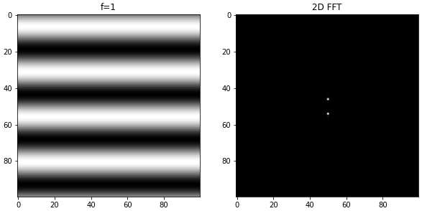
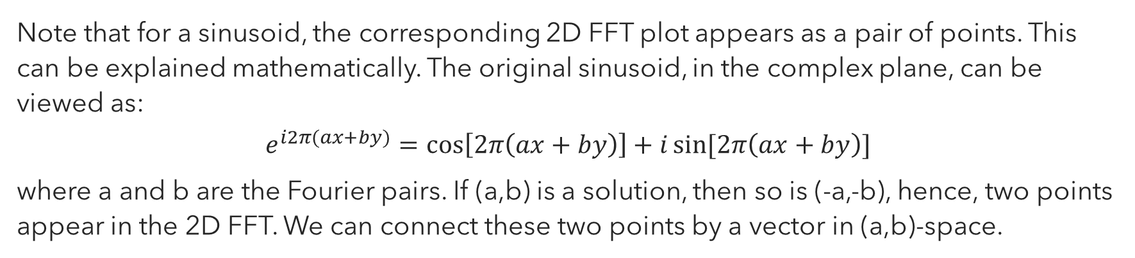
2D FFT of a Sinusoid
Note that for a sinusoid, the corresponding 2D FFT plot appears as a pair of points. This can be explained mathematically. The original sinusoid, in the complex plane, can be viewed as:
$$e^{i2π(ax+by)}=\cos\left[2π\left(ax+by\right)\right]+i\sin{[2π\left(ax+by\right)]}$$
where a and b are the Fourier pairs. If (a,b) is a solution, then so is (-a,-b), hence, two points appear in the 2D FFT. We can connect these two points by a vector in (a,b)-space.

Slide 6
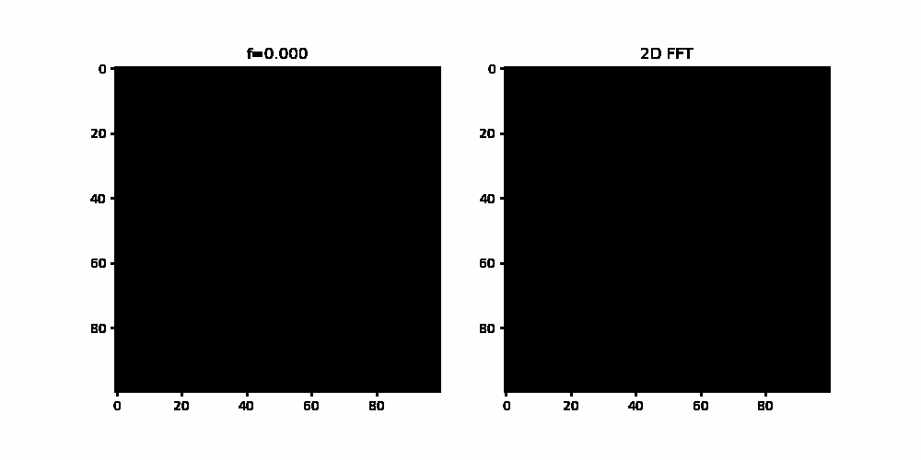
Effect of the Frequency on the 2D FFT
As the frequency is increased, the corresponding Fourier pairs (a,b) ought to increase as well, so their distance to the center of the 2D FFT image increases. The magnitude of the (a,b) vector indicates the frequency of the original sinusoid.

Slide 7
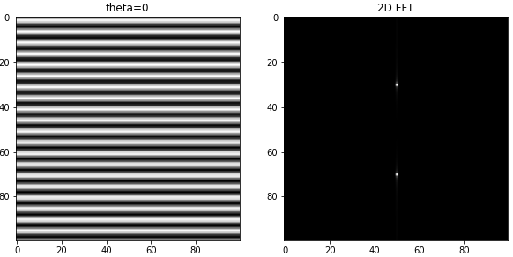
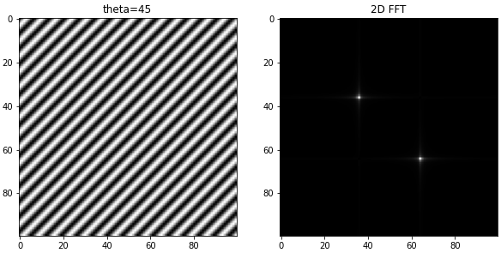
Effect of the Phase Angle on the 2D FFT
Note that this (a,b) vector has the same orientation as the original sinusoid, which is intuitive: the vector connecting these two points in the (a,b)-space has the same direction connecting the maxima (or minima) of the sinusoids.

Slide 8
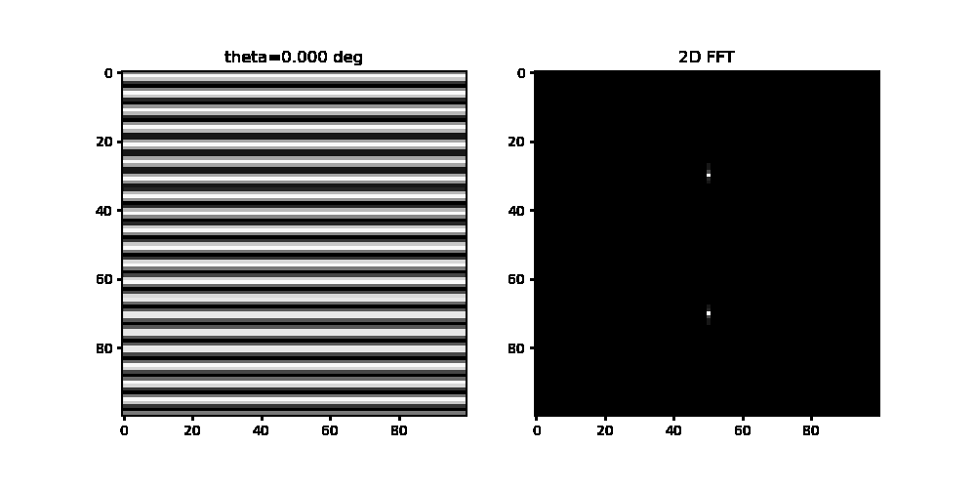
Effect of the Phase Angle on the 2D FFT
We can even see from the animation that as the phase angle increases, so does the direction of the (a,b) vector in the FFT space i.e., both “rotate” in the same orientation over time.

Slide 9
Objectives
Investigate the effect on the 2D FFT of a 2D sinusoid with varying phase and frequency.
Investigate the effect on the 2D FFT as multiple sinusoids are superimposed.
Perform image processing by filtering in the Fourier space.
Investigate the corresponding FFT of geometric shapes with varying properties.
Replicate a pattern using image convolution.

Slide 10
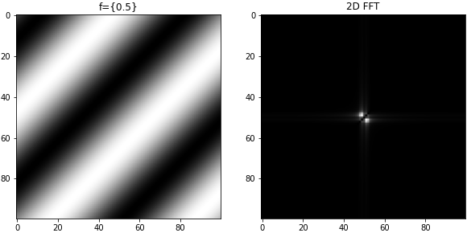
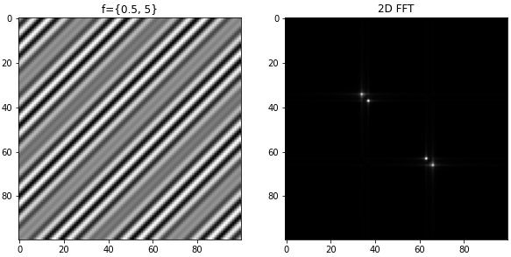
Superimposition of Frequencies
We can even combine sinusoidal waves with varying frequencies by multiplication of sinusoids; i.e,
corrugated_roof(np.pi/4, 0.5,100)*corrugated_roof(np.pi/4, 5,100)
This produces an image with frequencies 0.5 and 5, as shown in the right.
Note that the length of the (a,b) vector isn’t generally preserved by this operation.

Slide 11
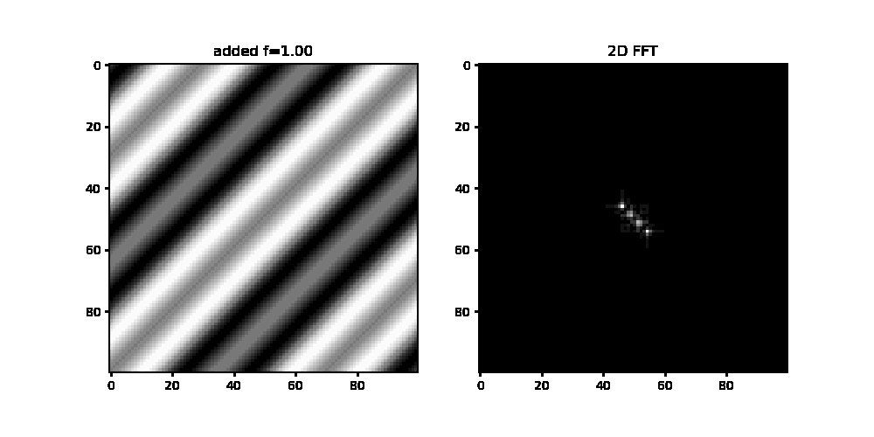
Superimposition of Frequencies
If the 2D function is a product of n sinusoids with varying frequencies, then the resulting 2D FFT has 2*n peaks.

Slide 12
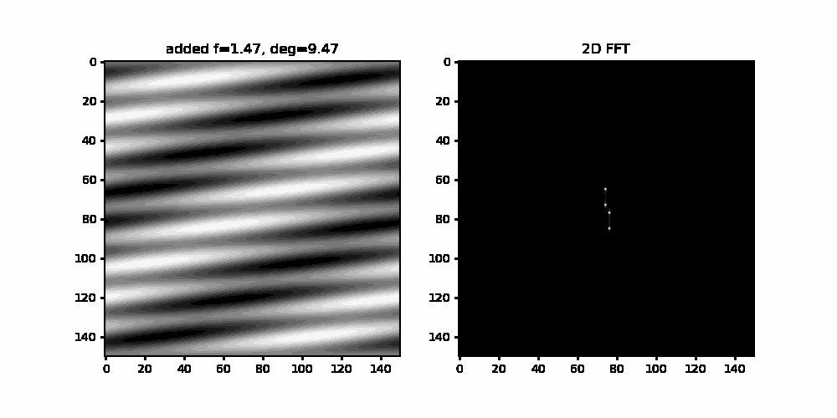
We combine all of these effects into a single, cool animation.

Slide 13
Objectives
Investigate the effect on the 2D FFT of a 2D sinusoid with varying phase and frequency.
Investigate the effect on the 2D FFT as multiple sinusoids are superimposed.
Perform image processing by filtering in the Fourier space.
Investigate the corresponding FFT of geometric shapes with varying properties.
Replicate a pattern using image convolution.

Slide 14
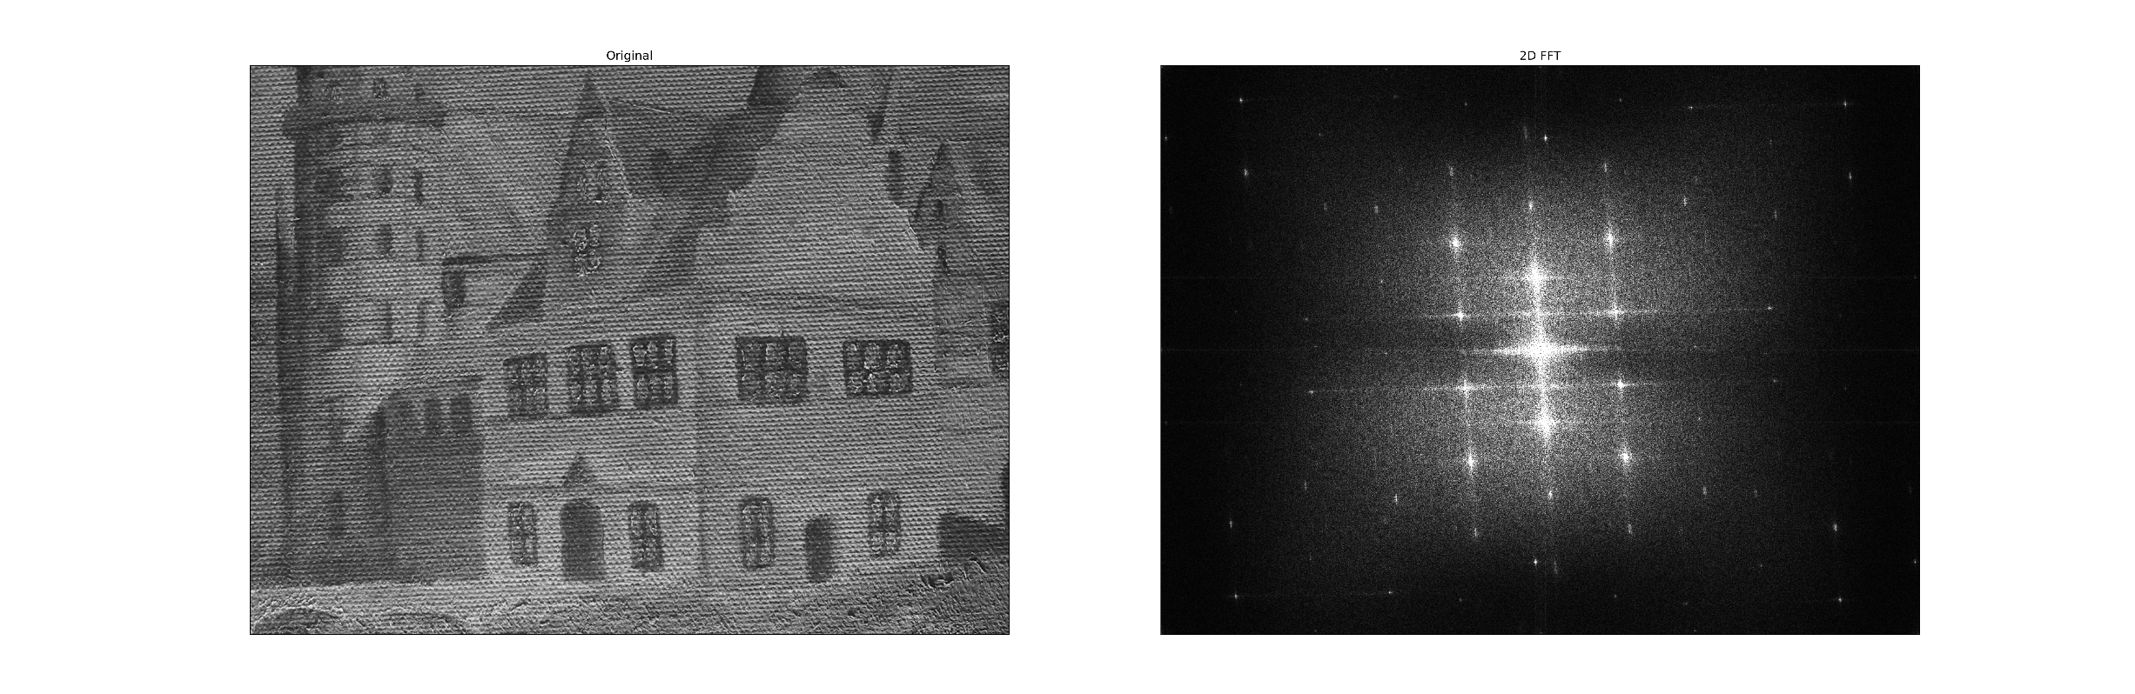
Fourier Filtering
Sometimes, images have unwanted, “high-frequency” artifacts like the canvas weave pattern of the painting above. These artifacts appear as high-frequency, symmetric points in the 2D FFT image. They are perhaps more evident when the original 2D FFT is contrast stretched or log-shifted; however, for my purposes, I find percentile stretching of the 2D FFT to be clearer (code was recycled from Module 1).

Slide 15
Fourier Filtering
Our goal is to remove these “unwanted” points by creating a mask in the 2D FFT array, and performing inverse Fourier transform on the “masked” 2D FFT array. If we want to retrieve the “weave pattern”, we just invert our mask, easily done by using np.logical_not.

Slide 16
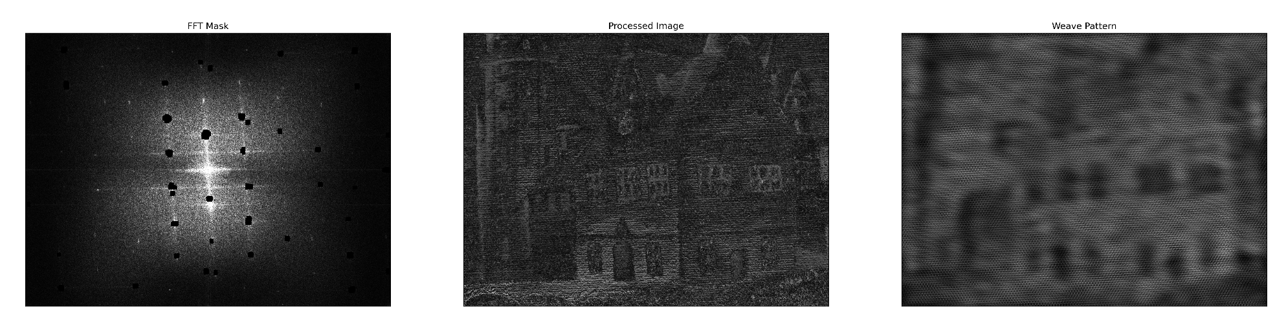
Automatic Masking
One can manually create a mask, but where’s the fun in that? Here’s my attempt at automation, which obviously has a lot of room for improvement, but what I’m more proud of is how I executed the idea (the journey matters more to me!). Although the image processing could use some improvement, the result weave pattern extraction is somewhat satisfactory.

Slide 17
Automatic Masking Algorithm
The algorithm I implemented works as follows:
Step 1: Perform percentile thresholding on each mxn subarray of the MxN fft2 image (localized thresholds).
Step 2: Use DBSCAN (density-based spatial clustering of applications with noise) algorithm to detect clusters of points (white specks) in a subarray.
Step 3: For the points in the detected cluster, generate a "blot" to increase the size of the mask.
Step 4: Remove all processing at the middle (cropping) to reduce image data loss.

Slide 18
Localized Thresholding
A quite naïve way of automating (although much faster) would be to set a global threshold of FFT intensity, and mask those values that exceed that threshold. However, this method runs the risk of “over-filtering” and possibly removing important frequencies.
An alternative that I came up with is to subdivide the original MxN array into smaller mxn arrays. Then, the usual thresholding is performed on each of these arrays. In exchange for less risk of overfiltering, we add another parameter to the algorithm: subarray size.

Slide 19
Localized Thresholding
This method depends on two crucial functions.
split_array as a function that takes the original MxN array as an input and returns a list of subarrays of user-defines sizes mxn (note that m and n need not necessarily be divisors of M and N, respectively, so the shapes of the subarrays in the list need not be the same).
restore_array as a function that takes as an input the list of the subarrays and outputs the original array, basically the “inverse” of split_array.
The idea is to process the subarrays and recombine them by using a variant of the restore_array function.

Slide 20
Localized Thresholding
def split_array(arr, M_sub, N_sub):
# Determine the shape of the original array
M, N = arr.shape
# Determine the shape of the subarrays
num_rows = M // M_sub + int(M % M_sub > 0)
num_cols = N // N_sub + int(N % N_sub > 0)
# Create a list to hold the subarrays
subarrays = [[] for _ in range(num_rows)]
# Split the original array into subarrays
for row in range(num_rows):
for col in range(num_cols):
subarr = arr[row*M_sub:(row+1)*M_sub, col*N_sub:(col+1)*N_sub]
subarrays[row].append(subarr)
return subarrays

Slide 21
Localized Thresholding
def restore_array(subarrays, M_sub, N_sub):
# Determine the shape of the original array
M = len(subarrays) * M_sub
N = len(subarrays[0]) * N_sub
# Initialize the restored array
restored_arr = np.zeros((M, N), dtype=subarrays[0][0].dtype)
# Restore the subarrays to the original array
for row, subrow in enumerate(subarrays):
for col, subarr in enumerate(subrow):
if subarr.size > 0:
restored_arr[row*M_sub:row*M_sub+subarr.shape[0], col*N_sub:col*N_sub+subarr.shape[1]] = subarr
return restored_arr[0:M,0:N]

Slide 22
DBSCAN
DBSCAN is a machine learning algorithm which I picked up when I was studying ML for fun back ago. It’s a cluster detection algorithm which depends on two important parameters: eps and min_samples. Here, a cluster can be defined as a neighborhood of points containing at least min_samples, with each point having a distance greater than eps.

Slide 23
DBSCAN
def detect_zero_clusters(array, eps, min_samples):
# Flatten the array into a list of points
points = [(i, j) for i in range(array.shape[0]) for j in range(array.shape[1]) if array[i, j] == 0]
if len(points) == 0:
# No clusters detected, return the original array
return array
# Run DBSCAN on the list of points
clustering = DBSCAN(eps=eps, min_samples=min_samples).fit(points)
# Get the indices of the points in the cluster
cluster_indices = [i for i in range(len(points)) if clustering.labels_[i] == 0]
# Create an empty array to hold the cluster
cluster_array = np.ones_like(array)
# Set the values of the cluster points in the array
for i in cluster_indices:
cluster_array[points[i]] = 0
return cluster_array

Slide 24
Cropping
The last step is trivial: remove all processing at the center of the image, defined by a rectangle with length L and width W. This is because most of the data lie in the center of the fftshifted FFT2 image.
def rect_cropper(arr, L=0.08, W=0.2):
Y,X = np.shape(arr)
mask = np.zeros((Y,X))
cen = np.array([1/2, 1/2])
cen_coord = np.array([cen[0]*Y, cen[1]*X])
low_y = int(cen_coord[1] - np.round(W*Y/2))
high_y = int(cen_coord[1] + np.round(W*Y/2))
left_x = int(cen_coord[0] - np.round(L*X/2))
right_x = int(cen_coord[0] + np.round(L*X/2))
mask[left_x : right_x, low_y : high_y] = 1
return np.array(mask+arr, dtype='bool')

Slide 25
The (monster) Algorithm
Combining everything, the algorithm I devised depends on seven parameters! Compare this to one by global thresholding.
def auto_masking(arr, M_sub, N_sub, threshold=98, eps=3, min_samples=8, blot_size=7, L=0.08, W=0.2):
M, N = arr.shape
# Determine the shape of the subarrays
num_rows = M // M_sub + int(M % M_sub > 0)
num_cols = N // N_sub + int(N % N_sub > 0)
# Create a list to hold the subarrays
subarrays = [[] for _ in range(num_rows)]
# Split the original array into subarrays
for row in range(num_rows):
for col in range(num_cols):
subarr = arr[row*M_sub:(row+1)*M_sub, col*N_sub:(col+1)*N_sub]
step1= threshold_masker(subarr, threshold)
step2= detect_zero_clusters(step1, eps=eps, min_samples=min_samples)
if 0 in step2:
step3=blotter(step2,size=blot_size)
else:
step3=step2
subarrays[row].append(step3)
semi_restored1=restore_array(subarrays, M_sub=N_sub, N_sub=N_sub)[0:M,0:N]
semi_restored2=rect_cropper(semi_restored1,L=L,W=W)
return semi_restored2

Slide 26
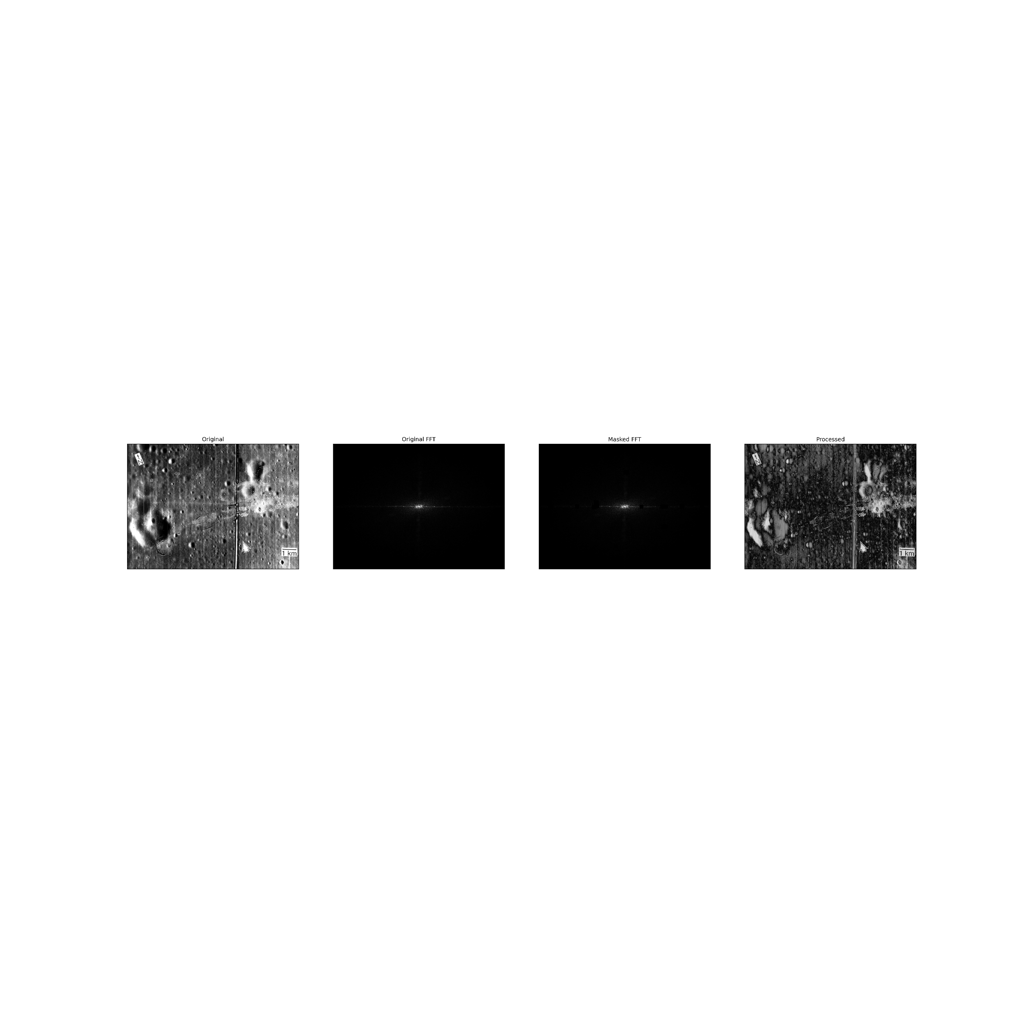
The (monster) Algorithm, applied on line removal
There are rooms for improvement on the algorithm, mostly because my execution is quite inefficient (takes a full second or two to fully run, depending on the parameters). The blotting procedure can also be improved (one idea is to convolve a “+” pattern on the detected clusters). Still, it’s a proof of concept!

Slide 27
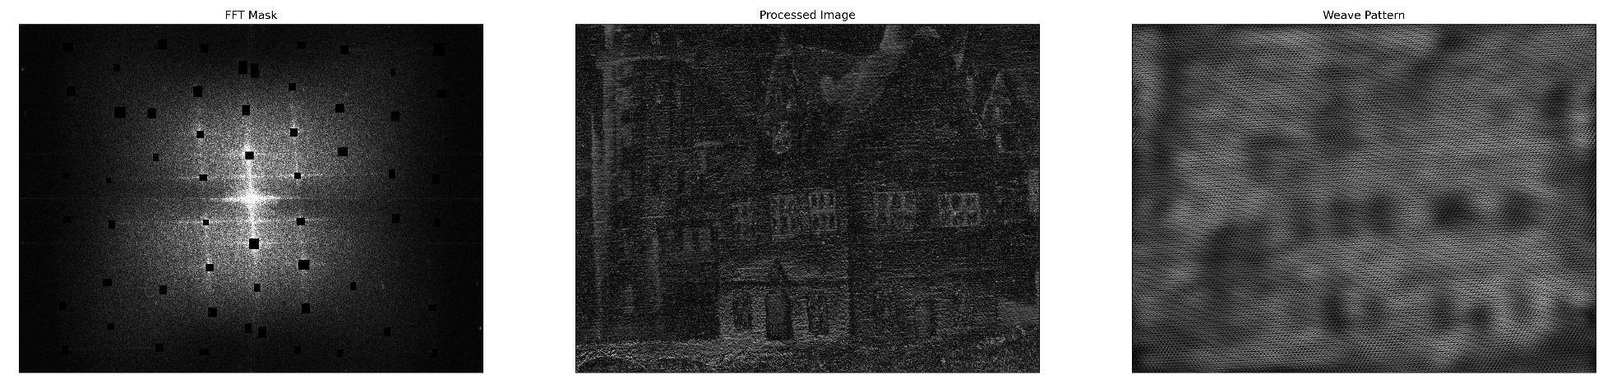
Manual Masking
Now the boring (but quick) method. The mask was generated using GIMP. I feel like I could’ve done better than just haphazardly adding rectangles (could’ve used “+” patterns instead) but at least I was able to successfully retrieve the pattern. The use of rectangles may have inadvertently caused the loss of data, resulting to a dark blurred image.

Slide 28
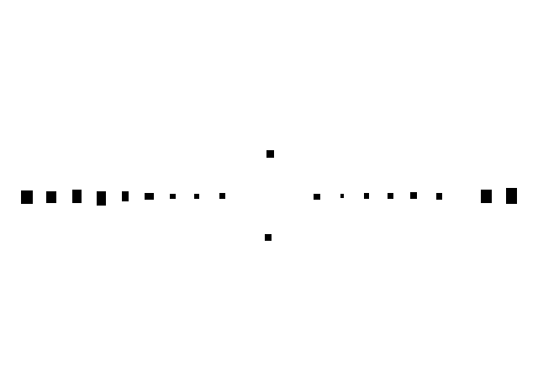

Manual Masking
The use of relatively large rectangles may also have inadvertently caused the loss of data, resulting to a darker image, although the “lines” were successfully removed.

Slide 29
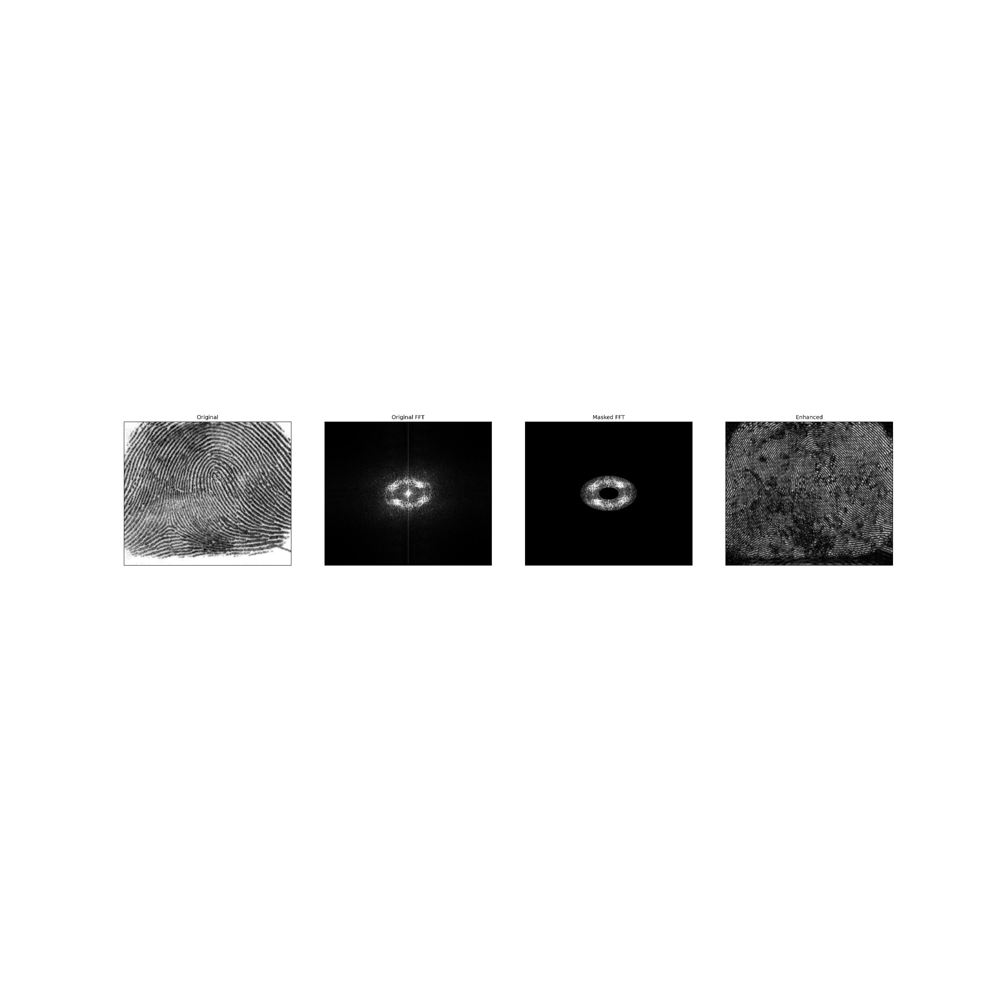
Fingerprint Ridge Enhancement
The concept of Fourier filtering and masking is useful in forensics since it can enhance fingerprint images, as shown above. The mask was generated by considering that the “curves” of the fingerprint marks can manifest as “symmetric” bright points. Note that this is now the reverse of what we were doing earlier.
The mask used was also generated in GIMP.

Slide 30
Fingerprint Ridge Enhancement
The enhanced image show the ridges more clearly.

Slide 31
Objectives
Investigate the effect on the 2D FFT of a 2D sinusoid with varying phase and frequency.
Investigate the effect on the 2D FFT as multiple sinusoids are superimposed.
Perform image processing by filtering in the Fourier space.
Investigate the corresponding FFT of geometric shapes with varying properties.
Replicate a pattern using image convolution.

Slide 32
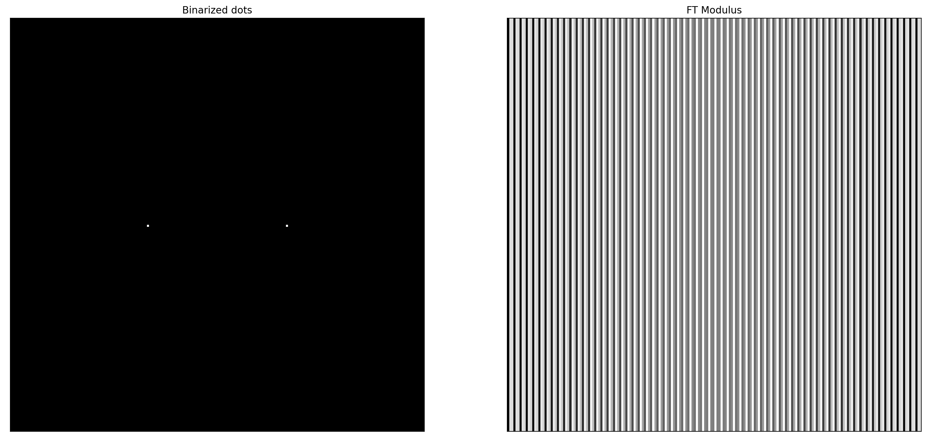
Binarized Dots
Note that the corresponding FFT of two dots is a single-frequency 2D sinusoid, just like how the FFT of a 2D sinusoid is two dots. This isn’t surprising, as the Fourier transform is a self-invertible operation.

Slide 33
Binarized Dots
def dots(number=2, N=200):
y = np.linspace(0,N, N+1)
x = y
X,Y = np.meshgrid(x,y)
vals = np.zeros((N,N))
cen = np.array([(1/2, (i+1)/(number+1)) for i in range(number)])
cen_trans = np.array(cen*N, dtype='int')
for c in cen_trans:
vals[c[0], c[1]] = 1
return vals
Here’s the code to generate two dots in an NxN array. We locate the coordinates of the dots, and assign a value of 1 by indexing on the vals array. This can be generalized into any number of dots.

Slide 34
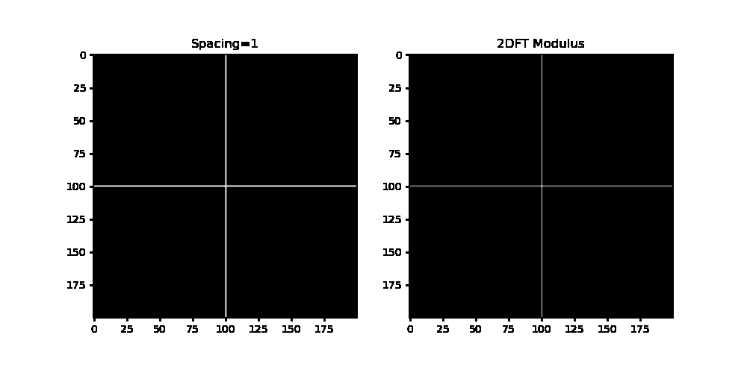
Equally-spaced Ones
Recall that each pair of point in the 2D FFT corresponds to a corrugated roof (sinusoid) with a particular frequency in the original image. The reverse is also true due to the invertibility of Fourier transform: We observe gratings on the 2D FFT modulus if we have equally spaced dots on the original image.

Slide 35
Equally-spaced Ones
def ones_cross(spacing, N=200):
r= np.arange(0,N, spacing)
a = np.zeros((N,N))
a[N//2, r]=1 #x-axis
a[r, N//2]=1 #y-axis
return a
Here’s a simple code to create equally-spaced points on the axes. We first assign a value of 1 on the points in the x-axis, then on the y-axis.

Slide 36

Circles
Note that the resulting FFT image of two circles look like a superimposition of an Airy disk and a corrugated roof (2D sinusoid). Moreover, at small radii, the Airy diffraction pattern is more evident, and more of the corrugated roof pattern can be seen (not surprising, as the circle appear more as points). The corrugated roof appears due to the symmetry of the original image. It can also be seen that the “intensity” maximum appears to shrink as the radii increases. One possible explanation for this is since the relative size of the aperture remains unchanged, the “spread” of the low-frequency Fourier coefficients remains unchanged. Since the overall plot size increases, this constant “spread” would appear smaller. If we zoom in; however, the granularity of the 2D FFT is reduced (see report on Module 2).

Slide 37
Circles
Here’s the code for the generation of n symmetric circles
def circles(number=2, D=0.1, N=100):
x = np.linspace(-1,1,num = N)
y= np.linspace(-1,1,num=N)
x= y
radius = D/2
X,Y = np.meshgrid(x,y)
cen = []
if number%2 == 0: #If even number of circles, include the circle at the origin
for i in range(1,number//2 +1):
cen.append((0,i/number))
cen.append((0, -i/number))
if number%2 == 1: #If odd number circles, do not include circle centered at origin
for i in range(1,number//2 +1):
cen.append((0,i/number))
cen.append((0, -i/number))
cen.append((0,0))
A = np.zeros((N,N))
for c in cen:
R = np.sqrt((X-c[1])**2 + (Y)**2) #Setup an offcenter circle.
A[np.where(R<radius)] = 1.0
return A

Slide 38

Squares
The same case can be said for two squares. Since they are symmetric on the x-axis, we expect a sinusoidal grating to appear in the 2D FFT modulus. Moreover, the associated diffraction pattern through a square aperture will also be observed in the FFT image.

Slide 39
Squares
The same case can be said for two squares. Since they are symmetric on the x-axis, we expect a sinusoidal grating to appear in the 2D FFT modulus. Moreover, the associated diffraction pattern through a square aperture will also be observed in the FFT image.

Slide 40
Objectives
Investigate the effect on the 2D FFT of a 2D sinusoid with varying phase and frequency.
Investigate the effect on the 2D FFT as multiple sinusoids are superimposed.
Perform image processing by filtering in the Fourier space.
Investigate the corresponding FFT of geometric shapes with varying properties.
Replicate a pattern using image convolution.

Slide 41
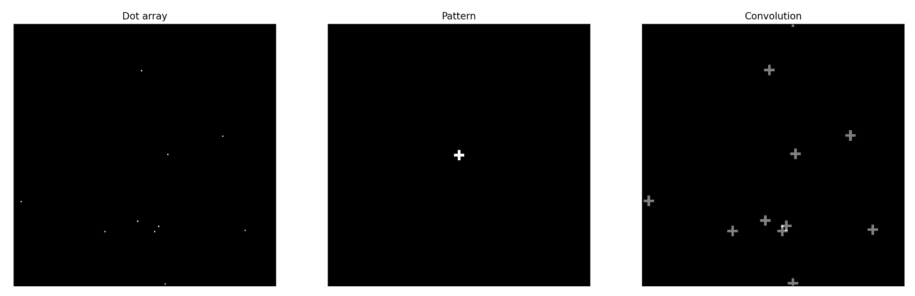
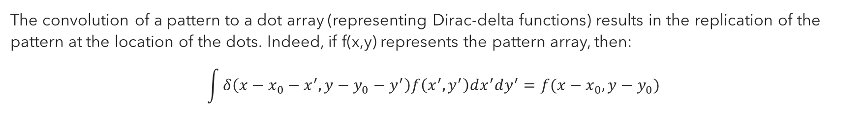
Binarized Dots
The convolution of a pattern to a dot array (representing Dirac-delta functions) results in the replication of the pattern at the location of the dots. Indeed, if f(x,y) represents the pattern array, then:
$$\int{δ\left(x−x_{0}−x^{′}, y−y_{0}−y^{′}\right)f\left(x^{′},y^{′}\right)dx^{′}dy^{′}=f(x−x_{0},y−y_{0})}$$

Slide 42
“Dirac-Delta” Dots and Cross Pattern
def dots_array(n=10, N=200) #Creates a NxN zero array with n random 1s interspersed
a=np.zeros((N,N))
for i in range(n):
a[np.random.randint(N), np.random.randint(N)] = 1
return a
def cross(width=1, length=9, N=200): #arbitary 9x9 pattern
vals = np.zeros((N,N))
min_x, max_x= int(N//2-width), int(N//2+width)
min_y, max_y = int(N//2-np.floor(length/2)), int(N//2+np.floor(length/2))
vals[min_x:max_x, min_y:max_y] =1
vals[min_y:max_y, min_x:max_x] =1
return vals
We emphasize that both the convolving aperture (pattern) and the original array (dots) must have the same size, similar to the correlation and pattern-matching we’ve done on the previous module.

Slide 43
Binarized Dots
dirac_deltas = dots_array(10, N=200)
pattern=cross(N=200)
pattern_fft2d = np.fft.fftshift(np.fft.fft2(pattern))
dots_array_fft2d = np.fft.fftshift(np.fft.fft2(dirac_deltas))
convolved = dots_array_fft2d*pattern_fft2d
deconvolved = np.fft.fftshift(np.fft.ifft2(convolved))
The final image is the inverse FFT of FG, where F is the FFT of the dot array and G is the FFT of the pattern or convolving aperture. We restore the correct orientation by performing fftshift on the final image.

Slide 44
Reflection
Honestly, I think I could’ve done better on tweaking the (monster) algorithm given more time. Nevertheless, I think that was the highlight of this module for me, since I got to actually apply some machine learning. Also, special thanks to ChatGPT for my buddy: although you were somewhat unreliable in writing error-free programs, you are a gold mine of insights (like raw, unpolished gemstones).
The mathematics and the resulting geometry of the 2D FFT is basically a rehash of what I established in the previous module, so explaining things were sort of easy.
I could’ve done better on the manual masking (use crosses, just like what Nino Ramones did).
Self-score: 110

Slide 45
References and Acknowledgments
Andreas Muller, Introduction to Machine Learning with Python.
ChatGPT (no, I didn’t just copy :p as I’ve explained in my reflection)
Special thanks to Nino Ramones for helping me with the ridge enhancement.
https://www.lpi.usra.edu/publications/slidesets/apollolanding/ApolloLanding/slide_05.html (Moon picture)
Dr. Vincent Daria’s painting (provided by Dr. Soriano)
https://www.researchgate.net/figure/Examples-of-different-classes-of-fingerprints-a-right-loop-b-whorl-and-c-arch_fig2_265986190 (fingerprint)

